Slide 1
SHUTTLEMARK
CLUB ACCREDITATION SCHEME
Recognising
Supporting
Developing
Rewarding Clubs

Slide 2
Overview
The aim of the program is to support clubs in developing and strengthening their infrastructure, planning for the future, and ultimately increasing their capacity and growth.
Key to a club’s success is boosting participation, developing coaches, volunteers, and the workforce, while having a clear plan for the future. Badminton Scotland is committed to recognizing, supporting, and rewarding the dedicated volunteers within clubs who are working hard to make this a reality.

Slide 3
STRATEGIC FRAMEWORK- SPORTSCOTLAND CORPORATE STRATEGY: SPORT FOR LIFE

Slide 4
BENEFITS
Below are benefits the scheme can provide to clubs and is aligned with Sportscotland’s 6 Priority Areas (Enablers & Qualities):
STRONG CLUB - Improving standards of club through developing the coaching workforce
PROMOTED CLUB - Can increase growth of club membership, support member retention, and help recruit volunteers
SAFE CLUB – Parents and teachers, or those associated or part of vulnerable groups likely to have more confidence in club
EFFICIENT CLUB - Indicates that your club is well-run, efficient and effective-saving volunteers time
SUPPORTIVE CLUB - Demonstrates that club values its volunteers through recognising their hard work
RECOGNISED CLUB - Can provide better access to grants as funding providers will consider accredited clubs over other clubs

Slide 5
How to get involved
Club Application Process:
Clubs can apply online or contact their local Regional Development Officers (RDOs).
Clubs must be affiliated with Badminton Scotland. The first step involves working with the RDO to ensure up-to-date membership figures (players, coaches, club helpers).
There is no fixed timeline for completing steps. Shuttlemark is here to support clubs, allowing them to progress at their own pace.
Document Submission
Clubs are required to upload all documents via JustGo

Slide 6
Support and Review
Support and Tracking:
RDOs will offer ongoing support and update the attached tracker at each meeting to reflect progress.
Review Process:
The review will occur every two years to maintain status.
Criteria Requirements:
Clubs must meet all relevant criteria. For instance, to achieve Gold, clubs must also meet all Silver and Bronze requirements.
Further Developments:
Clubs will not be restricted to Shuttlemark. If a club reaches the top level and wishes to continue developing by setting new goals and plans, the RDOs will remain available to provide ongoing support.

Slide 7
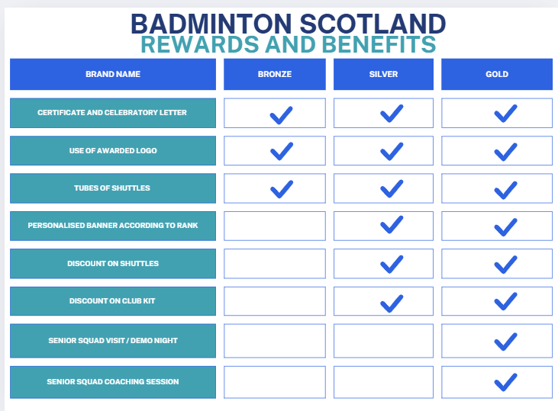

Slide 8
Stages and what is needed
The following slides showcases bronze silver gold and platinum and what exactly is looked at, needed and offered for support

Slide 9
Constitution
Committee
Bank Account
PVG, Child Wellbeing & Protection Policies and Procedures
Emergency Procedures
Club Session Operations
Coach level required

Slide 10
Club Welcome Pack
Code of Conducts
Effective Partnerships
Club Communication and Social Media
Club Officials – Active Line Judge / Umpire

Slide 11
3 Year Plan
Coach / Volunteer Development plan
Inclusion SIDC

Slide 12
For any further information
http://www.badmintonscotland.org.uk/shuttlemark-club-accreditation/

